Slide 1
API Performance Monitoring
Logs → ETL → MySQL → Analytics → Alerts → Power BI Dashboard

Slide 2
Project Objective
Ingestion and Validation
Proposed Solution
Logs are too many and messy
→ Hard to understand directly
Monitoring is manual and slow
→ We react after issues happen
Bad data is hidden or ignored
→ Causes wrong analysis
Build a complete monitoring pipeline
→ From logs → database → dashboard
Separate: ✅ Clean data | ❌ Rejected (bad) data
Use SQL to calculate:
KPIs (success rate, latency)
Risk metrics (slow queries, errors)
Show everything in Power BI dashboard
02/09

Slide 3
Architecture Flow
Updated End-to-End Pipeline (Final SQL Flow)
Log Generator
Validation
Storage Layer
SQL Analytics
Power BI
>
>
>
>
Raw events are generated continuously and written to data/raw/log.csv.
Business and technical validation separates clean records from rejected records.
system_logs, rejected_logs, and etl_metrics maintain analytic and governance state.
SQL scripts compute KPI, trend, tail-latency, and risk metrics for dashboards.
03/09

Slide 4
Data Model
Core Tables
Data Quality and Speed
system_logs: request-level fact table.
rejected_logs: invalid rows with reason.
etl_metrics: run totals and freshness.
system_logs_archive: long-term retention.
CHECK constraints protect data quality.
FK links rejected rows to ETL run.
Indexes speed time and endpoint queries.
Orphan check confirms audit integrity.
04/09

Slide 5
Analytics and Diagnostics Layer
Basic, KPI, Advanced, Diagnostics
KPI + Diagnostics + Action Queries
Basic:
traffic,
reliability,
latency.
Trend: spikes by minute and hour.
Endpoint:
slow
failure-prone APIs.
Advanced:
latency buckets,
risk scoring,
root-cause guidance.
KPI:
ETL quality and freshness.
Health score uses weighted reliability model.
Master adds rolling trend and spike detection.
Risk score prioritizes optimization work.
05/09

Slide 6
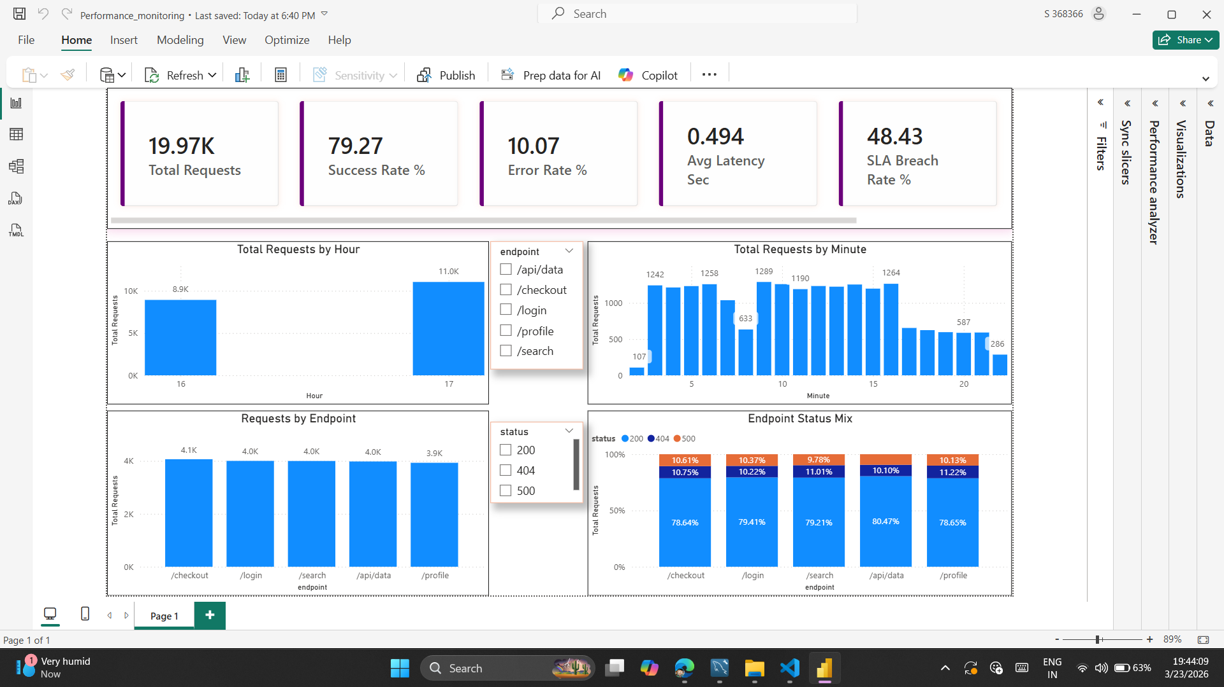
Power BI Dashboard

Slide 7
Power BI Output
Observed KPI Results
Meaning and Action
Total Requests: 19.97K
Success Rate: 79.27%
Error Rate: 10.07%
Average Latency: 0.494 sec
SLA Breach Rate: 48.43%
Traffic has clear peak windows.
Reliability is moderate, not ideal.
SLA breach is the top concern.
Fix high-risk endpoints first.
07/09

Slide 8
Business Impact
Key Outcomes
Detects slow queries BEFORE system failures.
Improves system reliability
Helps identify root causes quickly
Enables data-driven performance optimization
Helps teams proactively monitor and optimize system performance
Enables proactive monitoring and optimization
07/09

Slide 9
Strengths, Validation, and Roadmap
Current Strengths
Next Improvements
Complete flow from generator to dashboard.
Clean and rejected paths are separated.
Rejected data is stored and can be analyzed.
Risk scoring and root-cause actions add depth.
Automate runs with scheduling and alerts.
Add partitioning for larger datasets.
Add security(RBAC) and query validation checks.
Connect to real upstream sources.
08/09

Slide 10
Thank You
Instead of reacting to failures, this system helps detect issues early and act proactively.

